Slide 1
Relational Database Management System
Kays Meayan

Slide 2
Plan
What is RDBMS?
MySQL
PostgreSQL
SQL SERVER
Comparison

Slide 3
What is RDBMS?
RDBSM stands for Relational Database Management System.
A relational database management system is a program that allows you to create, update, and administer a relational database. Most relational database management systems use the SQL language to access the database.
The most famous RDBMS are MySQL, PostgreSQL, SQL SERVER, Oracle …

Slide 4
MySQL
MySQL is an open source relational database management system.
MySQL is the most popular SQL Database.
Used for all kinds of applications, it is most often associated with web applications and online content publishing.
It is compatible with almost all platforms including Linux, Mac and Windows.
MySQL allows data to be stored and accessed on multiple storage engines including InnoDB, CSV, and NDB.
For security, MySQL uses a system of access privilege and encrypted passwords for checking hosts.
MySQL is considered one of the very fast database languages, backed by a large number of the benchmark test.

Slide 5
PostgreSQL
PostgreSQL is a powerful, open source object-relational database management system that uses and extends the SQL language combined with many features that safely store and scale the most complicated data workloads.
PostgreSQL runs on all major operating systems : Windows, Linux, Mac OS, FreeBSD …
PostgreSQL has earned a strong reputation for its proven architecture, reliability, data integrity, robust feature set, extensibility
PostgreSQL support most popular programming languages: JavaScript, C, C#, JAVA, Python…
PostgreSQL is compatible with multiple Data Types like Structured types(Array, Date,…), Premitive types(String, Integer,…), Document types(Json, XML,…)
PostgreSQL is compatible with Data Integerity wich include : Primary Keys, Foreign Keys, Exclusion Constraints, …..
It is safe because it follows several security aspects.

Slide 6
SQL SERVER
SQL Server also known as Microsoft SQL Server is a relational database management system developed by Microsoft.
SQL Server store and retrieve data for the same or other applications. We can run these applications on the same computer or a different one.
SQL Server is easy to install and configure
SQL Server comes in several editions to cater to the needs of corporate enterprises and domestic and remote users.
SQL Server have Excellent Data Restoration and Recovery Mechanism.
The SQL Server database is highly secure and uses sophisticated encryption algorithms making it virtually impossible to break the security layers.
SQL server includes effective data management and data mining tools along with disk partitioning.

Slide 7
Comparison

Slide 8
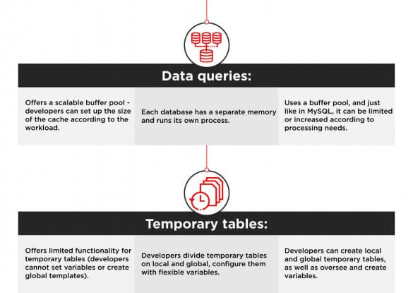
Comparison

Slide 9
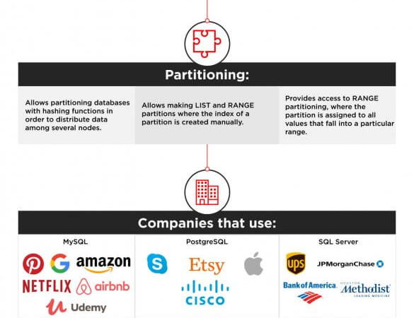
Comparison

Slide 10
Thank You!

